Slide 1
Introduction to Crypto
1
Market Places and Market Makers
Kathryn Zhao
Denis Imaev

Slide 2
Introduction to Crypto
Maximal Extractable Value: Arbitrage scenario
Trader submits an order transaction to buy a large quantity of a coin
Arbitrage bot discovers this transaction by looking at the pool of transactions not yet included in the blockchain
Bot inserts its own transaction to buy, paying a higher fee to ensure that his transaction gets included in the chain earlier and is executed earlier.
Bot also includes a transaction to sell right after the trader’s transaction
Trader’s large transaction gets filled after the bot’s, driving the price higher.
Bot sell trade now executes at a higher price.

Slide 3
Introduction to Crypto
MEV and Arbitrage
You are welcome to try this at home… at your own risk!!!
There are techniques to counter this strategy, you may be played too!!
Remember that many crypto assets are tokens with their own governance. Their code may include specific trading rules to prevent arbitrage. In DeFi, there are predators who hunt predators
Being a DeFi degenerate is a lot of fun, but be careful in your trading - because this game is highly adversarial and we play for keeps.
(https://github.com/Defi-Cartel/salmonella)

Slide 4
Introduction to Crypto
MEV: opportunities for Everyone
It is not just Miners/Validators: anyone can profit from MEV
Searcher: scanning the chain for opportunities
DEX arbitrage: buy on one DEX and sell on another in one transaction
Sandwich trading (discussed above)
NFT: buy the drop before everyone.
NFT: find an erroneously low price

Slide 5
Introduction to Crypto
MEV (continued)
Still debated whether if it is good or bad … or should be illegal?
In Equities world, front-running and a big no-no
Validators may attempt chain reorganization (definitely bad!)
Some argue its good too: free market sniffing out inefficiencies
Help projects find and fix implementation deficiencies
Needs expressive capabilities like ETH
The more complicated things you are trying to do, the more likely it is that someone will take advantage of it.

Slide 6
Introduction to Crypto
“MEV” on Bitcoin
MEV on bitcoin after BTC became more “complex”
Bitcoin MEV (and other manipulations) are harder on BTC because its simpler. That’s an advantage! Simplicity → Security
Ordinals Protocol: individual BTC satoshis can be unique
Buy a specific Ordinal can be seen by everyone. It is possible to pay higher fee and replace the original buyer with the front-runner.
Empty block mining: no TX in it but the miners gets the reward
Miners can collude to mine “non-standard” (“premium”) transactions (MEV generalized)

Slide 7
Introduction to Crypto
Wallet analysis
Transactions (even unconfirmed) are a signal
Funds moving from wallets to exchanges: bearish signal

Slide 8
Introduction to Crypto
Dark Pools
Submitted transactions are visible to all
Solution? Go off-chain
Dark Pools: private, permissioned mempools
Pay validators to hide their TX in private mempools
Private pools → loss of transparency of the network, concentration of control
Similar trends in other asset classes (rise of Dark Pools in Equities)

Slide 9
Introduction to Crypto
Automated Market Makers
First Proposed by Vitalik Buterin (one of the inventors of Etherium).
They were an attempt to solve a problem of low liquidity and high cost of trading (through fees).
Natural development of the idea that everything is governed by code.
Trading also facilitated by code is code. Why not get code to help with liquidity?
Different price discovery model:
Instead of buyers and sellers actively “agreeing” on the price through active interaction via order book, the price is determined algorithmically within in a special kind of a Smart Contract: Automated Market Maker.

Slide 10
Introduction to Crypto
Automated Market Makers
Key idea (simple): the relative price of an asset against another asset is a direct reflection of the supply and demand (im)balance.
Let us fix this relationship with an equation.
Create a pool of two assets
Make their relative price depend directly on their relative quantities
When quantities change, price changes accordingly
There may be different “equations”: AMM Curves

Slide 11
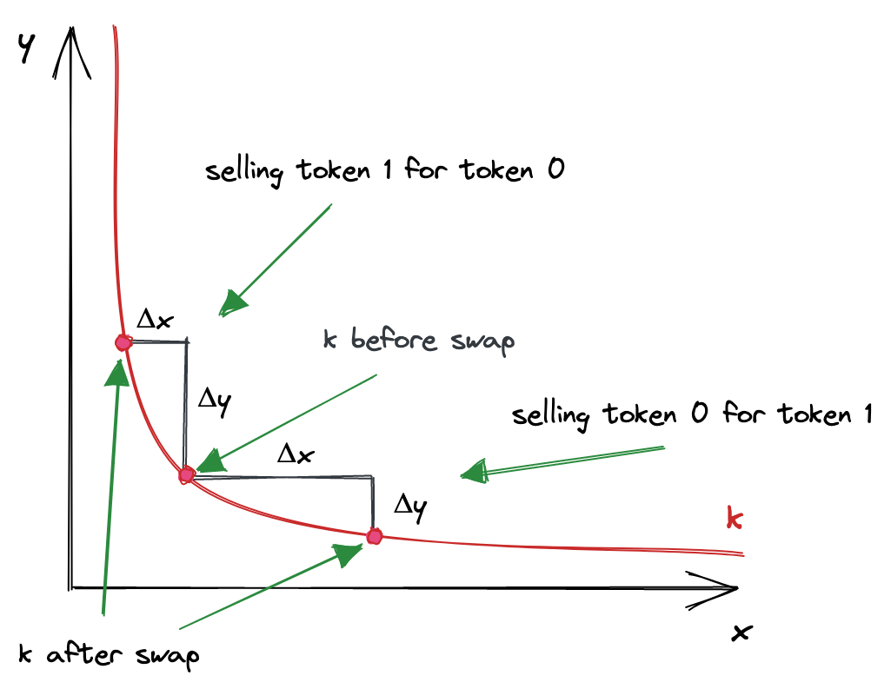
Introduction to Crypto
Constant Product AMM
Assets A and B with quantities Qa and Qb:
Qa * Qb = k (constant)
To buy dX of the A token: pay dY of the B token where dY is such that
(Qa − dX) × (Qb + dY) = k

Slide 12
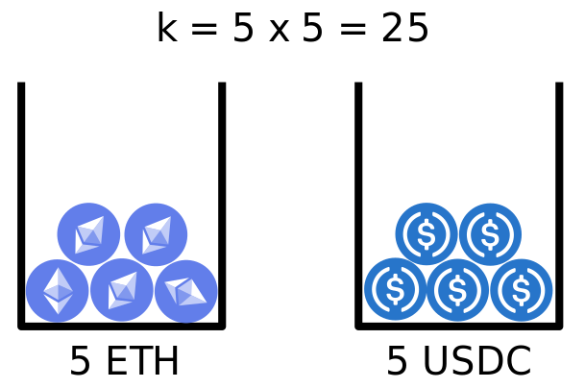
Introduction to Crypto
Pool of 5 ETH and 5 USDC
Initially, 1 ETH = 1 USDC

Slide 13
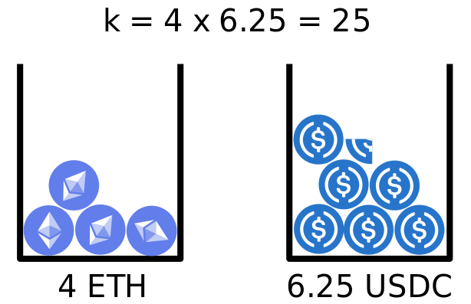
Introduction to Crypto
Buy 1 ETH: 1 ETH is removed… How much USDC needs to be added?
1 ETH = 1.25 USDC! ETH demand decreases USDC price

Slide 14
Introduction to Crypto
Impermanent Loss
Price of a token may differ significantly from the original equilibrium and from the overall “market” price
Market forces gradually bring the balance back (hence “impermanent”)
Arbitrageurs buy the underpriced assets in the pool to liquidate somewhere else, restoring the equilibrium. So be patient.
AMM pools compensate liquidity providers with portion of fees for suffering IL.
IL is less pronounced with Stablecoins and Liquid pairs

Slide 15
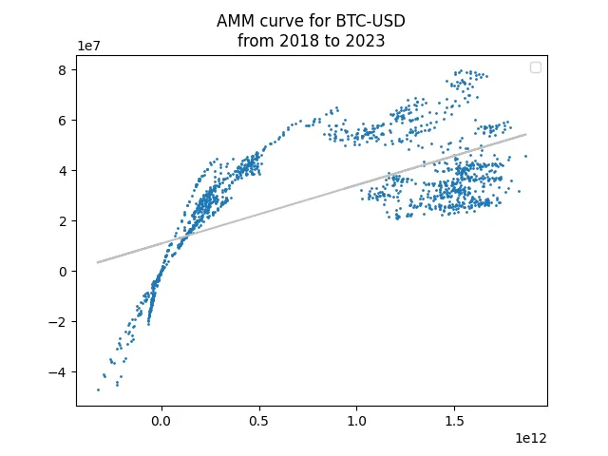
Introduction to Crypto
AMM Curves must make sense! Not any equation is suitable
Badly constructed AMM curves cause devastating issues: FTX

Slide 16
Introduction to Crypto
AMM disadvantages
“Impermanent Loss”: price depends only on asset balance in the pool, it can fluctuate significantly from the “real” market price and can also be manipulated.
Large trade causes significant price impact.
Arbitrage between two different pools is possible, because price fluctuation in one due to a large trade is NOT propagated to the other quickly enough.
“… front running in the CPAMM model is always profitable whereas it is not in the standard market making model. This is a fundamental and intrinsic problem in the CPAMM market maker model….”
(https://kenaninstitute.unc.edu/rethinc/wp-content/uploads/2022/03/Park_-Andreas-Automated-Market-Makers.pdf )

Slide 17
Introduction to Crypto
17
UST (Luna) Failure: when Automated Trading goes bad
Dual-token system:
Stablecoin itself like TerraUSD (UST) and the governance token LUNA
Demand for UST high, price > $1:
Burn LUNA / mint some UST, increasing supply
Demand for UST low, price < $1:
Buy UST and burn it in exchange for LUNA worth exactly $1. Increased demand and decreases supply pushes the price back up, in theory
All depends on the protocol adoption for market players to be involved!

Slide 18
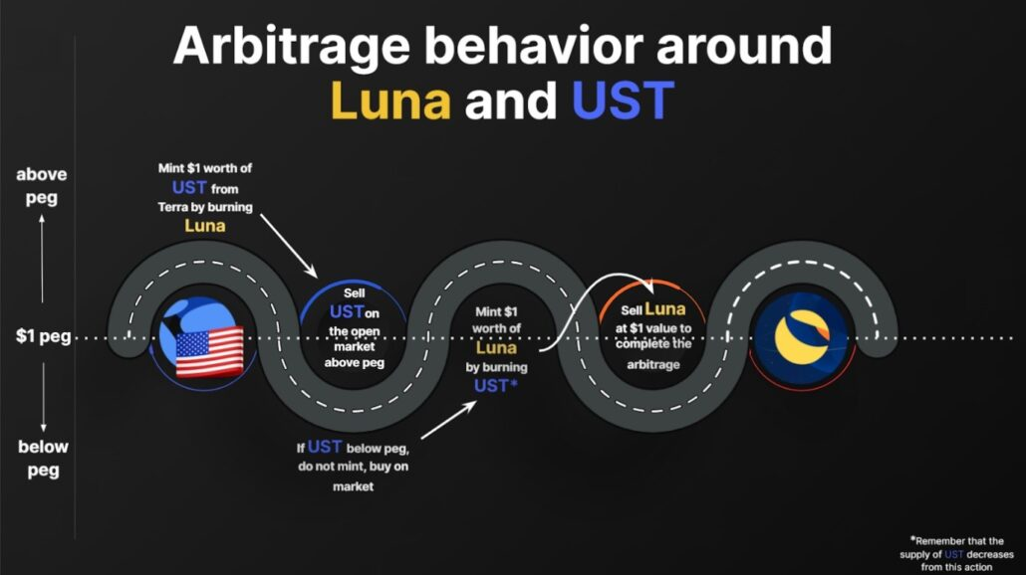
Introduction to Crypto
18
UST (continued): arbitrage ensuring stability
Source: https://www.gate.io/learn/articles/what-is-luna/114

Slide 19
Introduction to Crypto
19
UST (continued): The Crash
Good old Bank Run: reserves are not enough when everyone is selling.
In May 2022, Terra’s organization liquidity pool witnessed a sizable withdrawal. This shook market participants’ confidence: they started dumping UST and the price tanked.
The protocol tried to algorithmically bring UST back to $1 by burning UST and minting more Luna
Total supply of Luna went from about 725 million tokens on May 5, 2022, to about 7 trillion on May 13, 2022
Death spiral: UST price falling → LUNA issuance increasing → LUNA price falling → UST panic sell → UST price falling

Slide 20
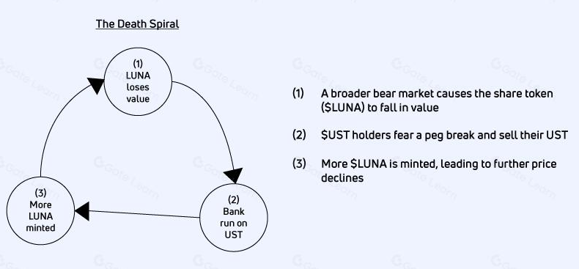
Introduction to Crypto
20
UST (continued): Death spiral
Source: https://www.gate.io/learn/articles/what-is-luna/114

Slide 21
Introduction to Crypto
AMM future: real innovation or danger?
It is yet to be seen how successful AMM to become
But its an attractive idea, so vigorous research continues…
Hybrid of Order Book and AMM to reduce AMM price slippage
Most terrible of the problems by DeFi are likely to be resolved eventually, as the DeFi industry matures.
We have an advantage of witnessing how a breakthrough develops, and it is both fascinating and educational.

Slide 22
Introduction to Crypto
CEX vs DEX: jury is out there…
DEX problems can be fixed by moving some things off the chain…
Best of both worlds? Can CEX and DEX co-exist?
An idea:
Order Book can live off the chain
Only trades committed to the blockchain
(immediate settlement)

Slide 23
Introduction to Crypto
CEX and DEX: There’s a place for everyone
Their coordination is even desired in certain cases: blocking stolen assets.
Use case is ALEX Labs hack in May 2024 using a bug in their bridge
Post-attack, major crypto exchanges acted swiftly to freeze the stolen funds, preventing the hacker from liquidating the assets.
Efforts within the crypto industry to combat hacking incidents and protect users.
The frozen funds aim to secure platforms and avert illegal activities, contributing to a more resilient crypto ecosystem.
“The incident serves as a stark reminder of the critical need for stringent security practices in the DeFi sector“

Slide 24
Introduction to Crypto
Crypto CEX: Still “Tricky” (fall 2024)
Fragmentation: dozens of (large enough) venues
No clear API standards. FIX?
Order handling and protections are unlike other asset classes:
Coinbase cancels orders far from market
Tick size and minimal order size are tiny
Compare with Equities typical tick size: 0.01, quantity size: 1
Slow
NASDAQ NY data center roundtrip: ~ few ms
Coinbase roundtrip: ~ 200 ms

Slide 25
Introduction to Crypto
CEX fragmentation and analysis
Pairs listed
Liquidity and depth
Fee structure
Technical characteristics
Order types supported
Other: margin trade etc.
Backers, jurisdiction…
FTX, Binance. What was wrong with them?

Slide 26
Introduction to Crypto
Over-The-Counter trading
No “marketplace” where buyers are matched with sellers.
Crypto OTC Trading is trading crypto assets directly between two parties in a closed trading market.
Parties negotiate deals based on the amount each party has or is interested in buying, i.e. prices are private.
Trading with principal desks or OTC trading markets entails using funds to purchase requested assets upon request of their customers.
This implies that the OTC trader is assuming risk in the process on behalf of their customer.
“Quote-driven markets”: OTC dealers stream prices continuously

Slide 27
Introduction to Crypto
OTC Advantages
Anonymity / confidentiality (private deal)
Flexibility: trade conditions are agreed/negotiated between parties directly. There are no regulations. No standard hours.
Price stability: ability to trade large quantities without incurring large impact (arguably) with pre-determined price.
One of the reasons why OTC is very popular with institutional traders.
Especially when dealing in less liquid assets.
Simplicity: no need to look for liquidity in multiple sources.
OTC brokers benefit from strong integration / relationships with reputable custodians.
Custodians store all kinds of assets on everyone’s behalf: they may have what you need

Slide 28
Introduction to Crypto
OTC disadvantages
Lack of oversight: potential price manipulation.
Prices set by OTC brokers may reflect their own goals, perceptions and risk assessment, not the real market conditions.
“Last-look” is used just like with FX.
No price transparency: you get what your broker gives you
Gaming opportunity: OTC traders receives valuable market information from having private access to (potentially large) client trades.
So there IS market impact… just not so obvious and hard to quantify.
Counterparty risk of dealing with one entity

Slide 29
Introduction to Crypto
OTC for institutions
Highly preferred by institutions
In 2023, OTC market size averaged $1.44 billion / day.
For comparison, institution-only LMAX and ErisX reported only $75 million / day.
However, overall spot trading (including retail traders) is still dominated by CEX when factoring in retail trading
In 2015 FX markets produced “The FX global code”.
Perhaps, crypto OTC traders will benefit from self-regulation too …

